Slide 1
Structural Simulation of Jet Engine Bracket

Slide 2
What is the aim?
Learn to make a good JEB
What is a good JEB?
JEB is good if it is stiff and light.
That is, the JEB must have minimum mass
The maximum stresses should be well below the Yield Strength of the material.
If the peak stress is comfortably low, there should be less amount of stress concentration zones.
Considering the designs in our dataset are comfortably below Yield Strength of the material, let us first have a look into the stiffest design and the lightest design to get a qualitative idea.

Slide 3
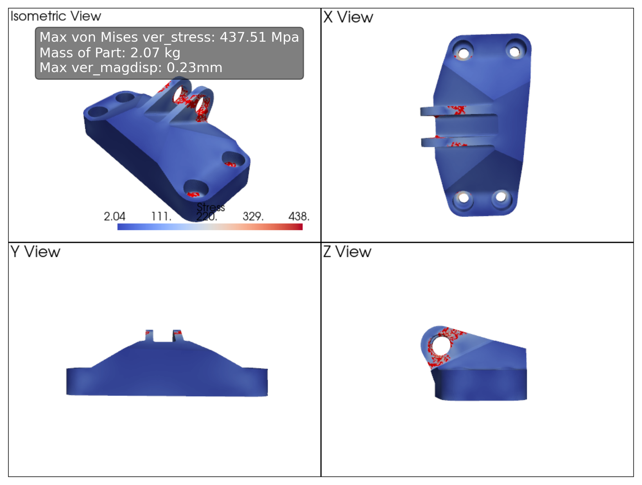
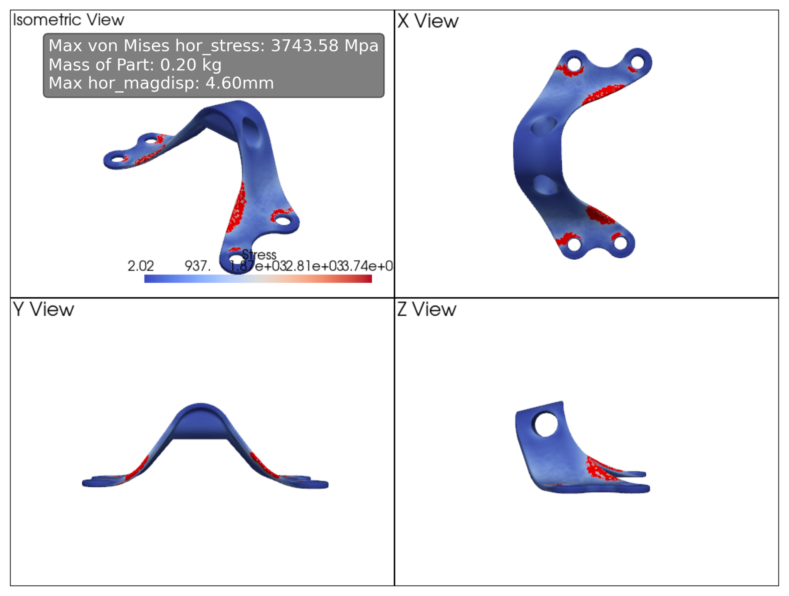
Design with maximum stiffness
Design with minimum mass

Slide 4
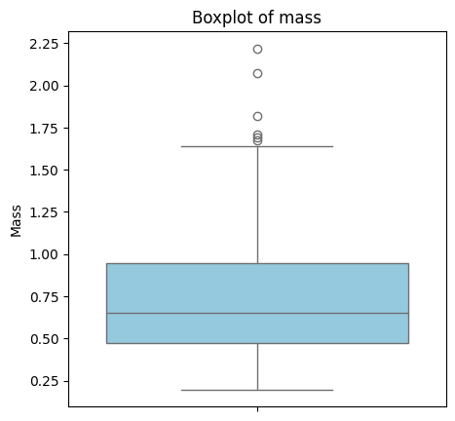
Remove all the designs that have mass above the 75th quantile

Slide 5
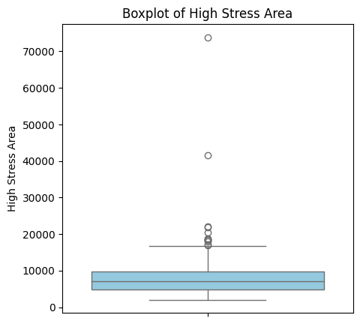
Now let us focus on the strength of the designs
OUTLIER JEB
29, 82, 123, 142, 245, 281, 378, 389, 390, 464, 545, 550

Slide 6
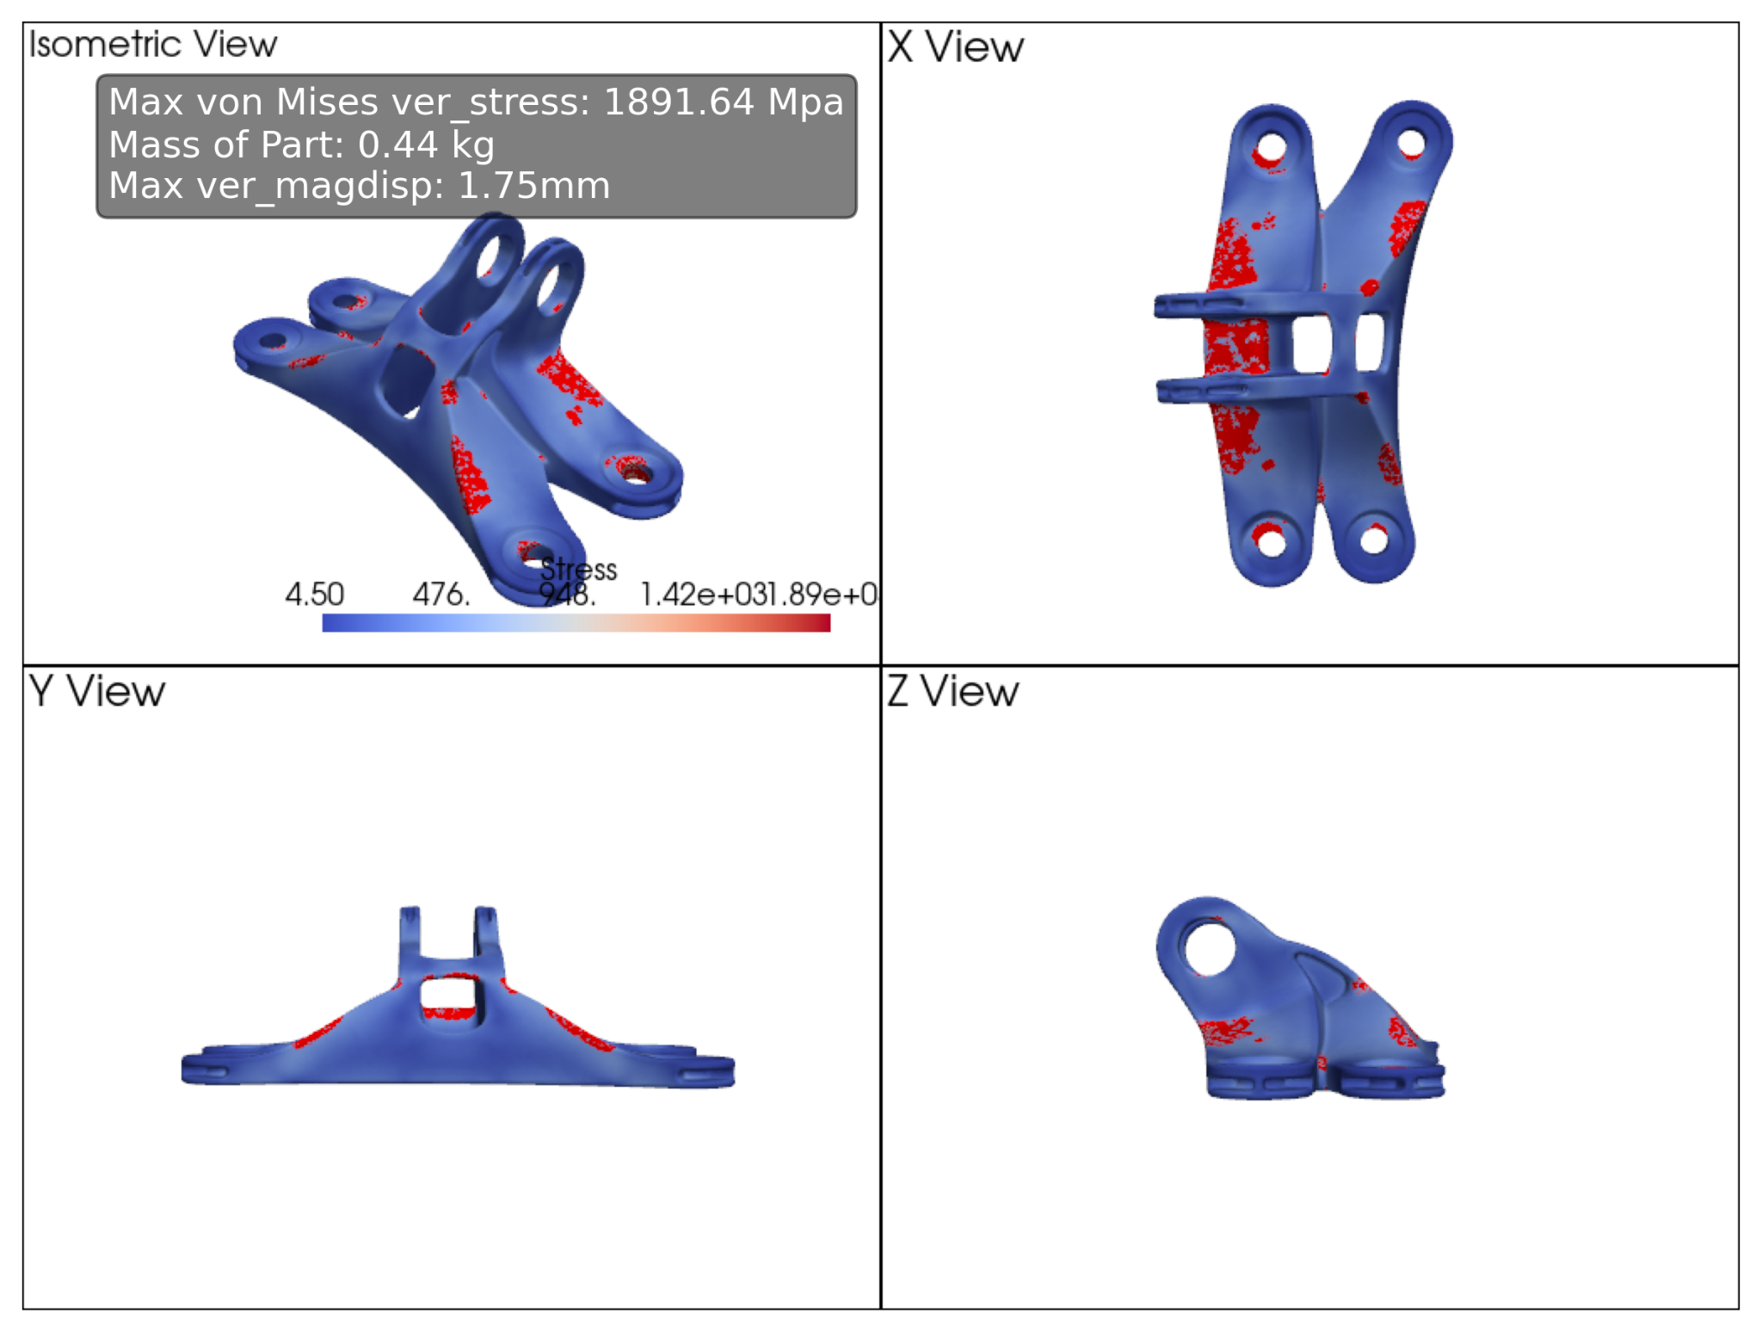
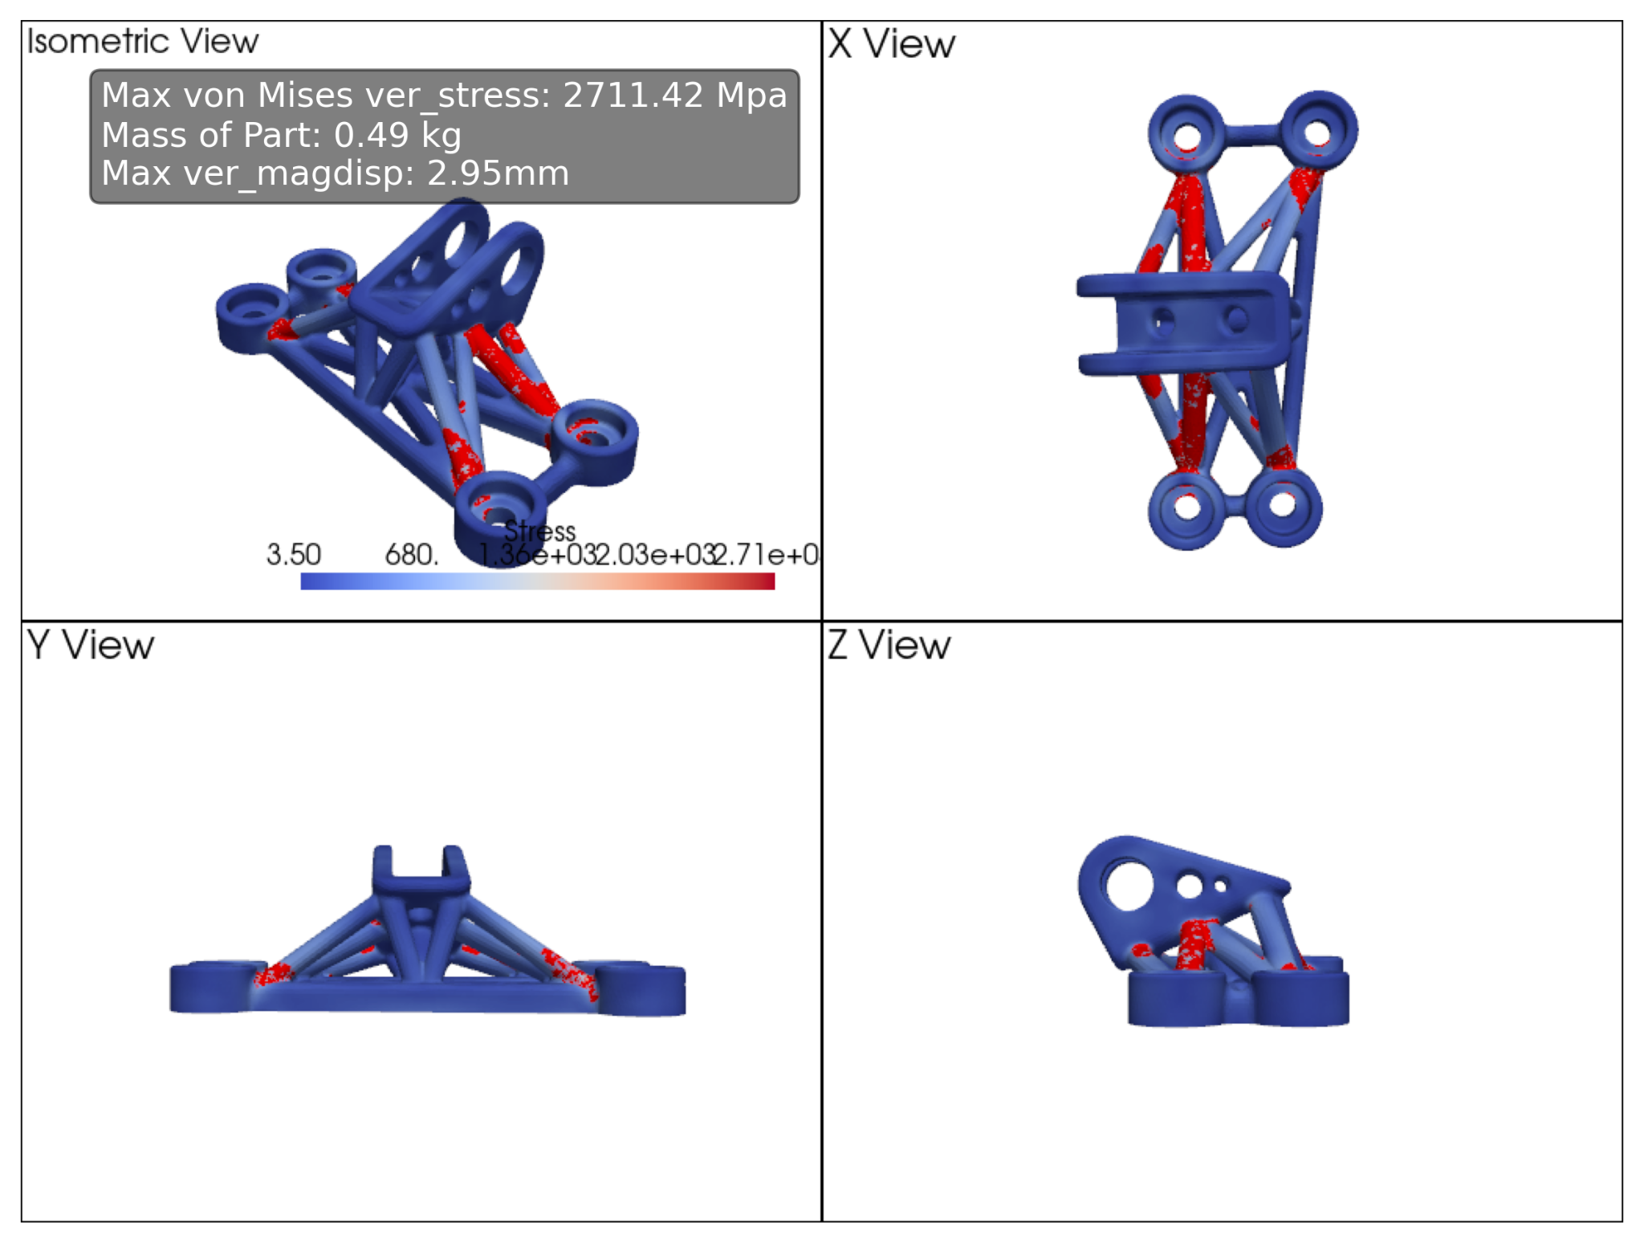
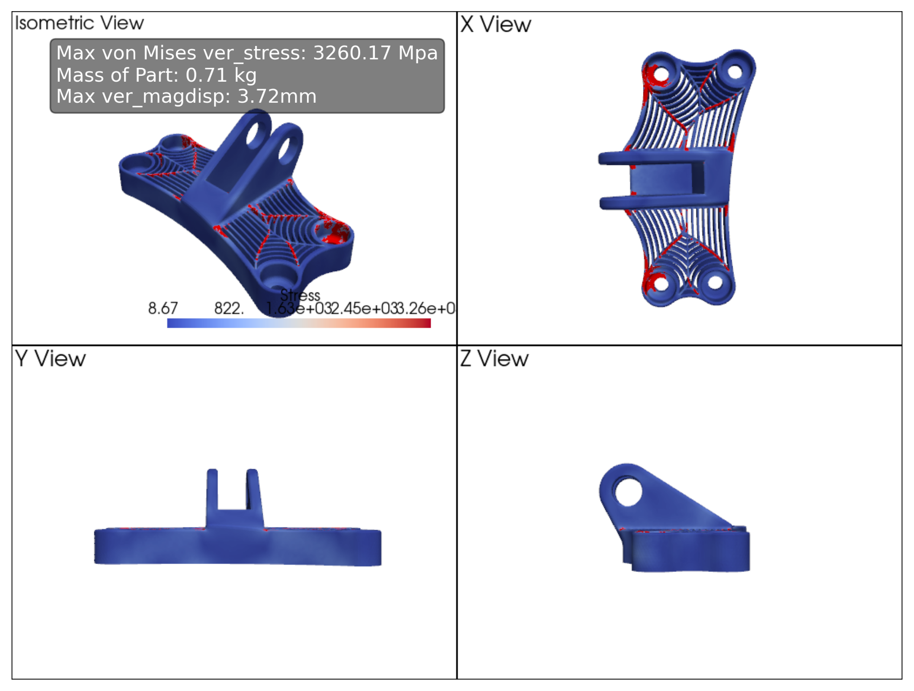
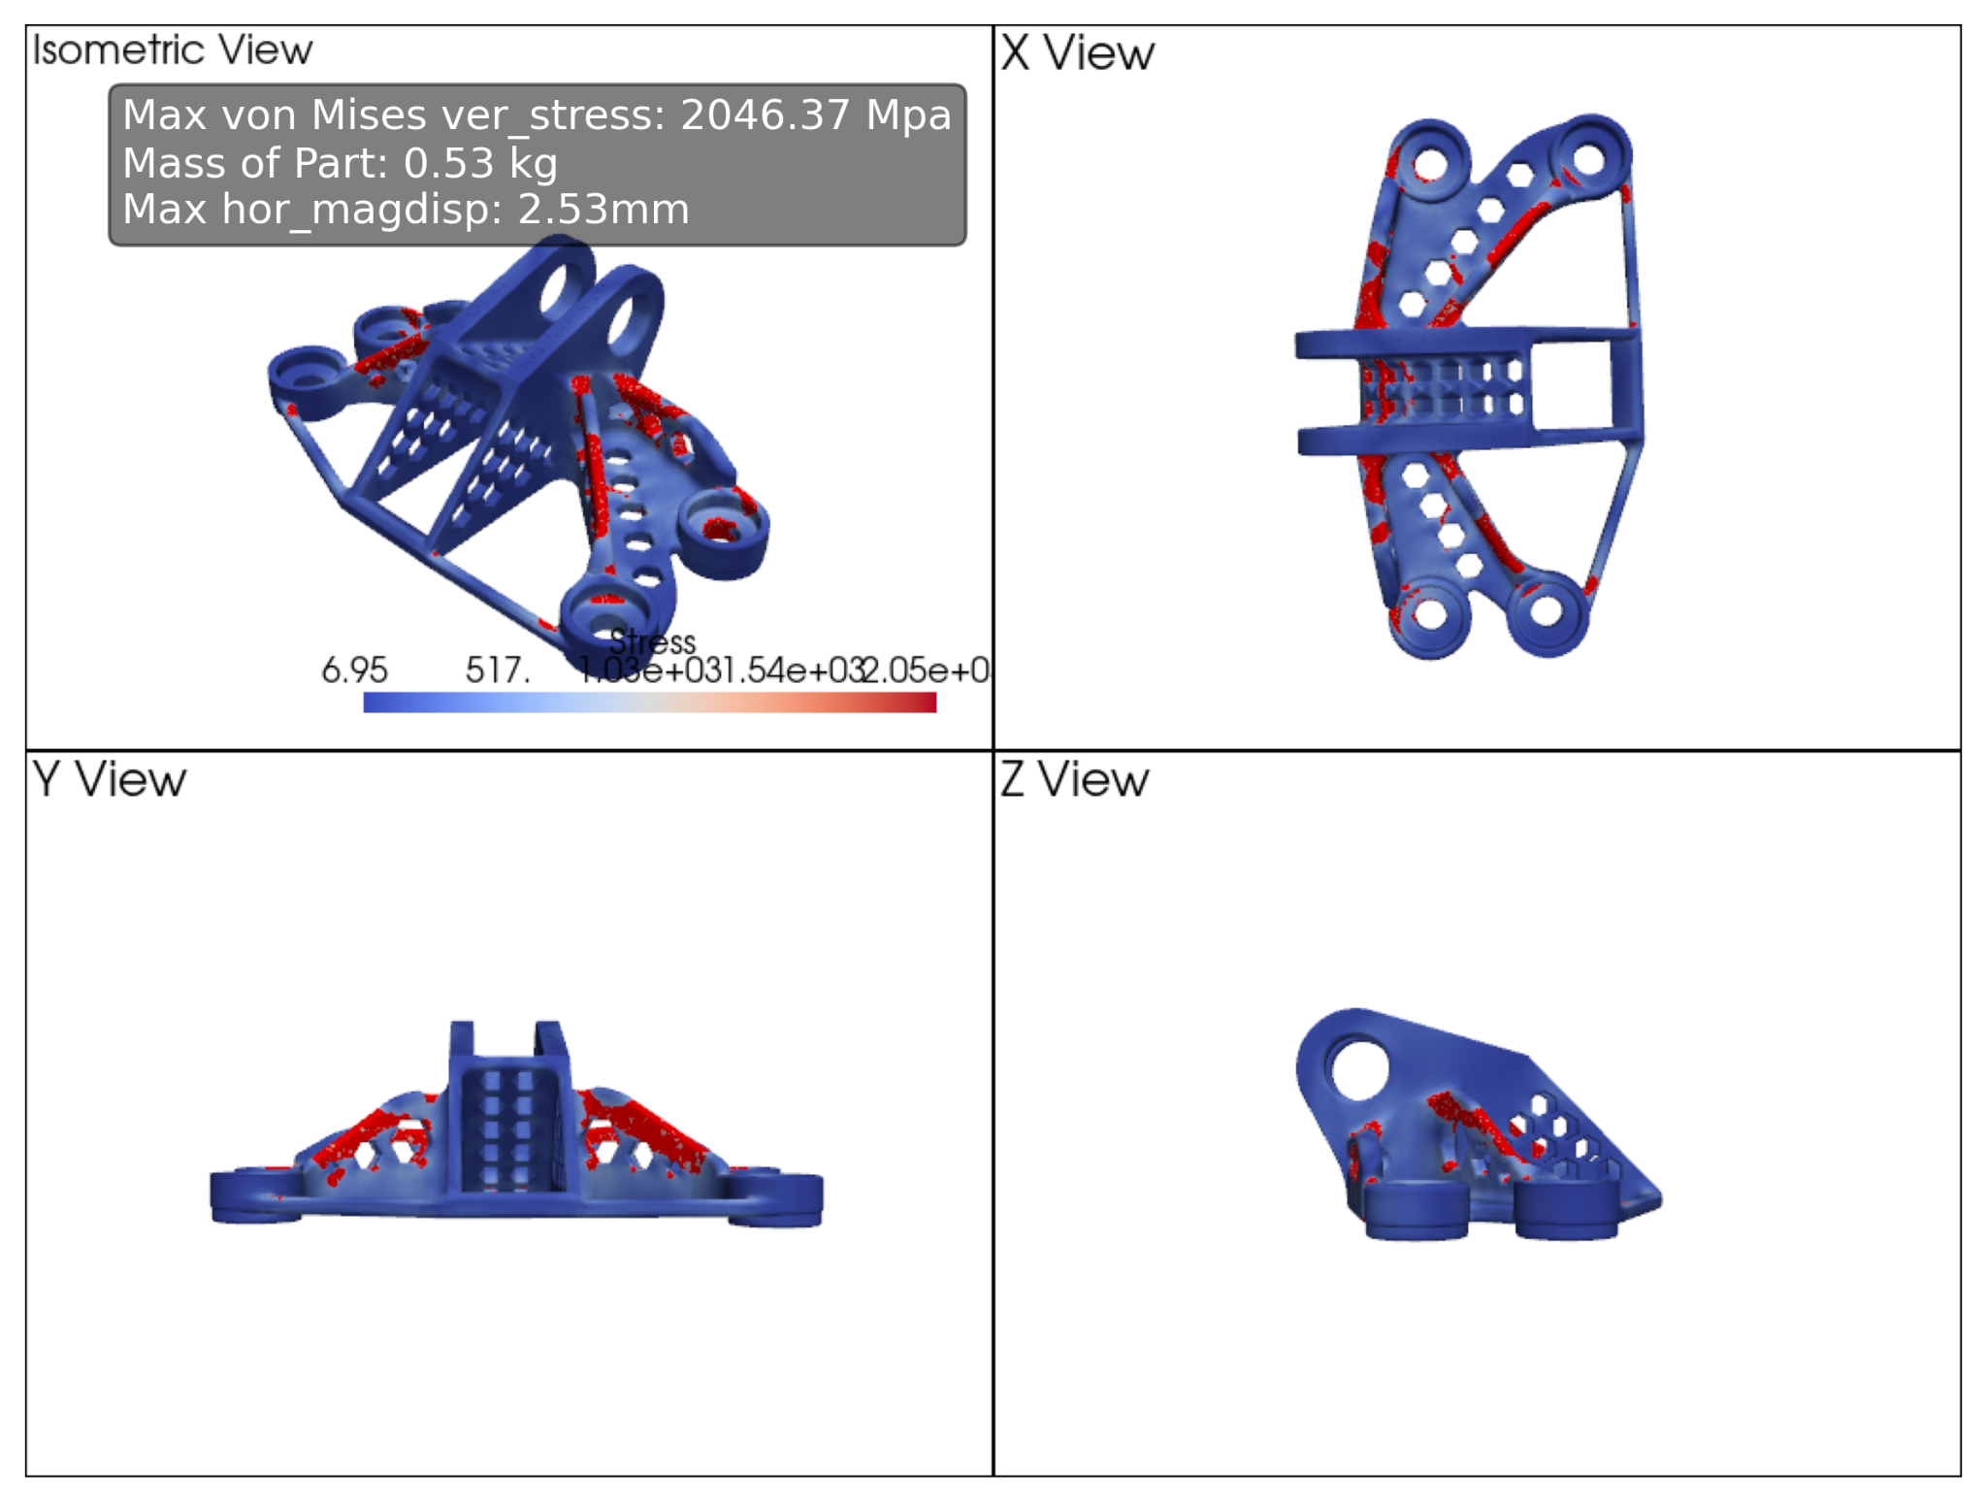
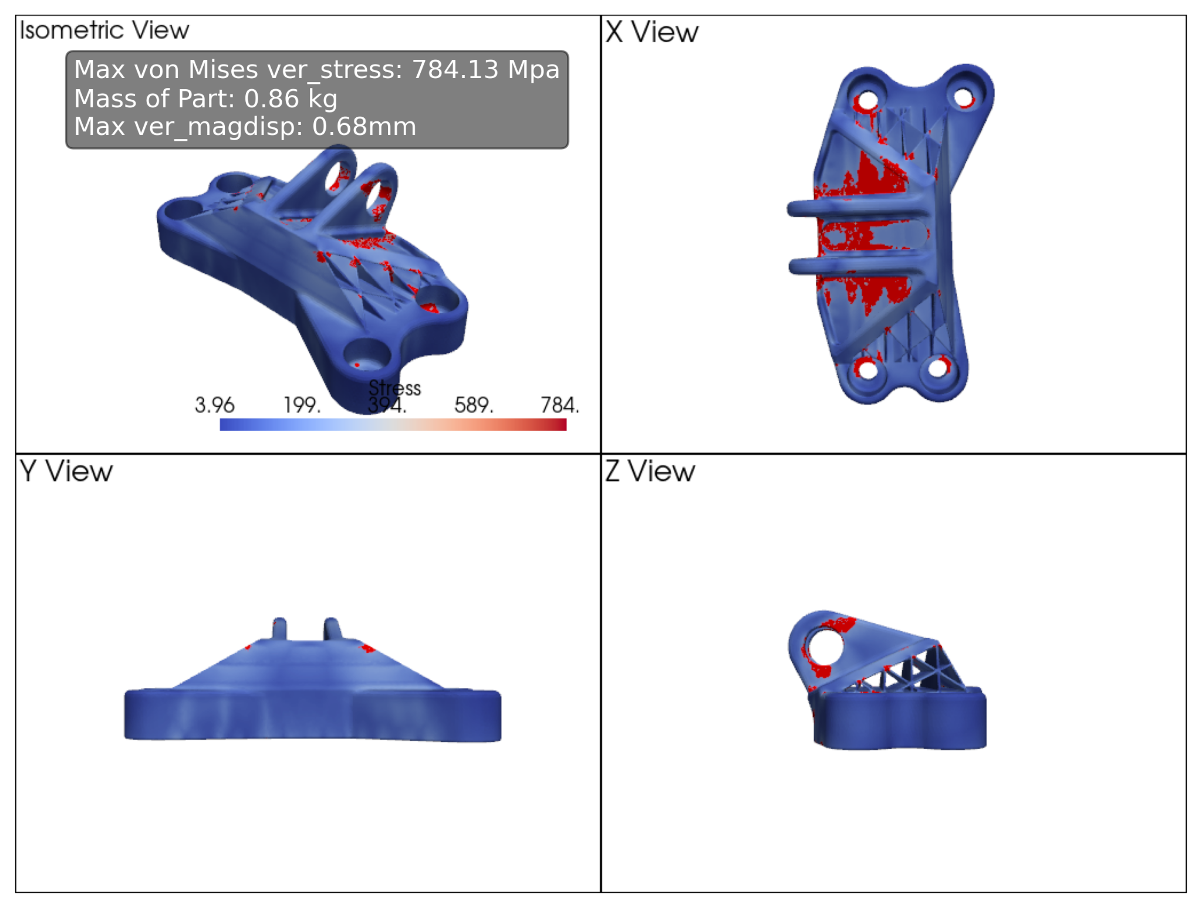
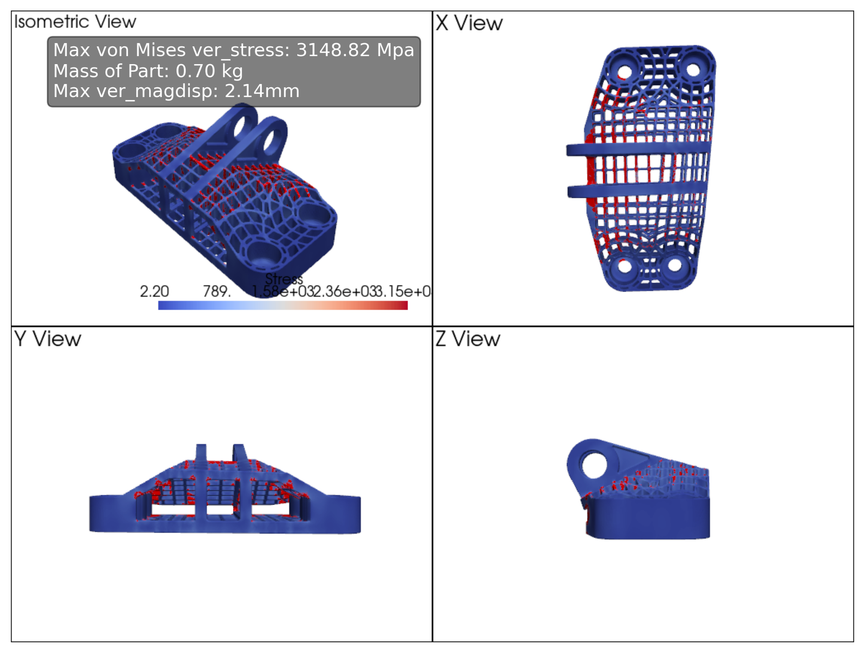

Slide 7
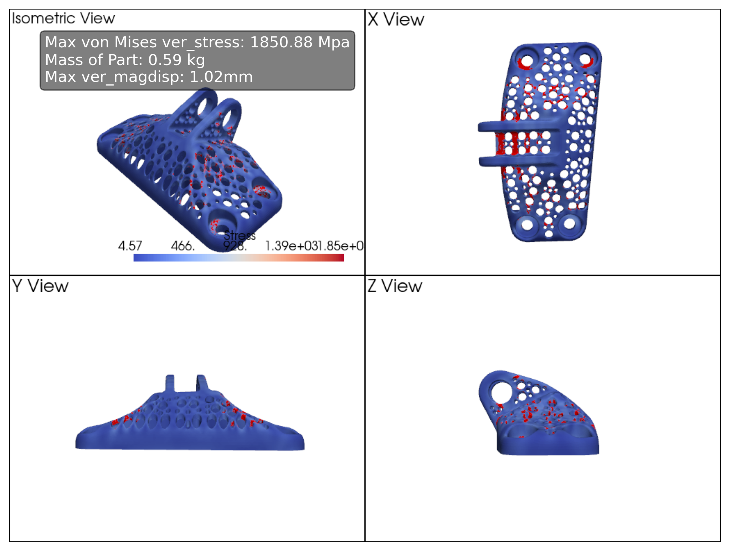
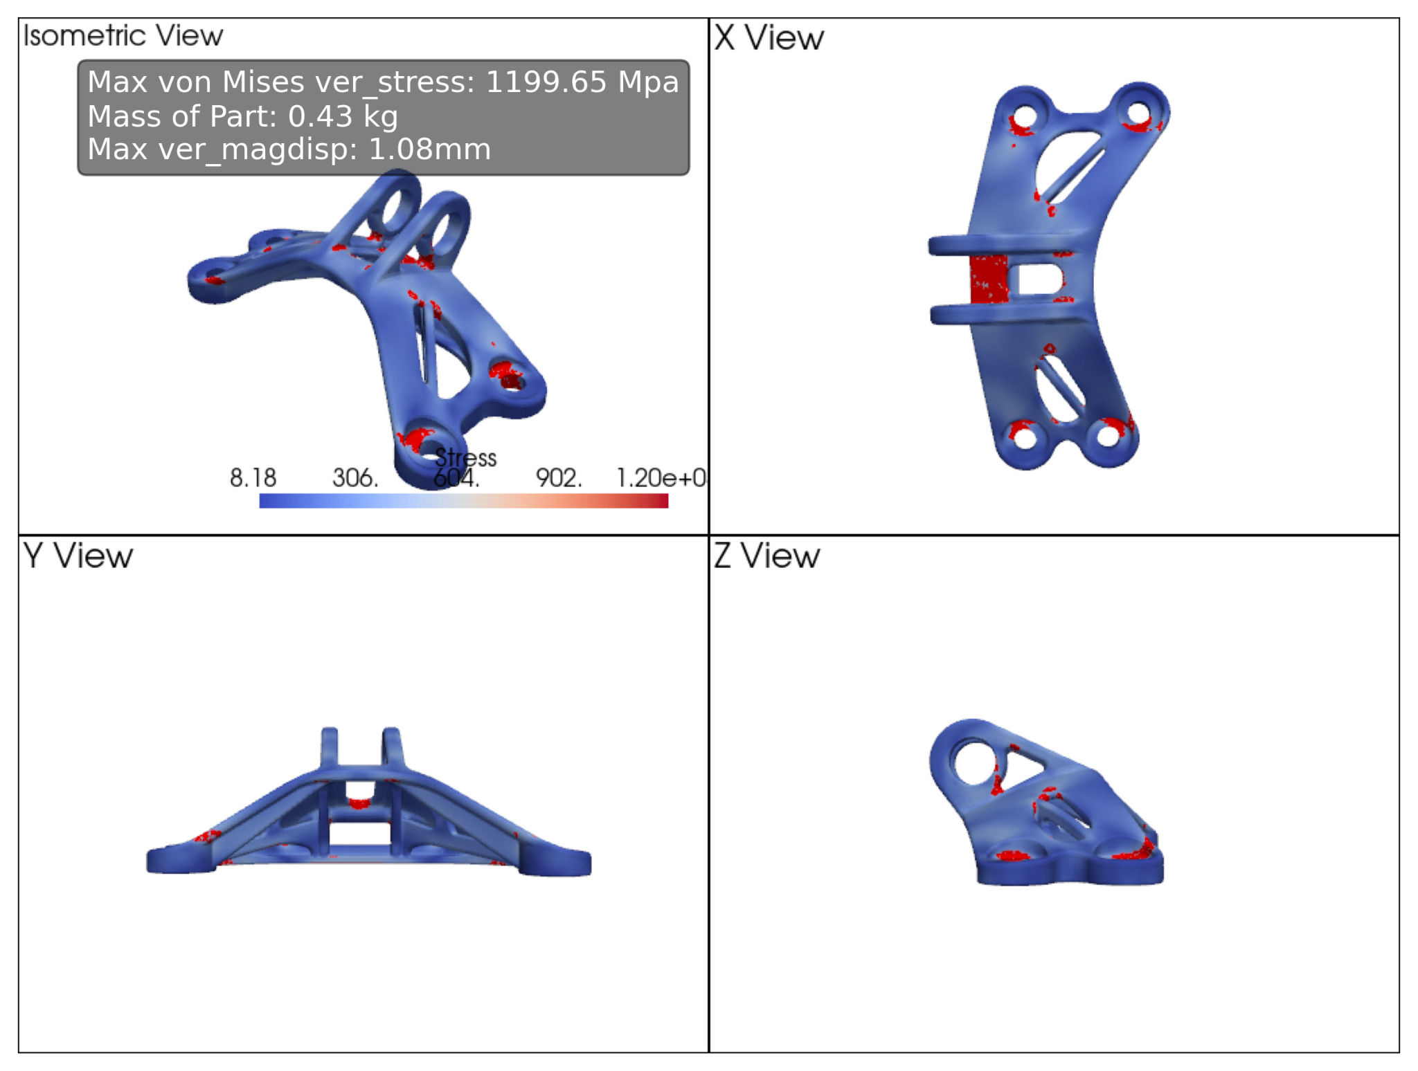
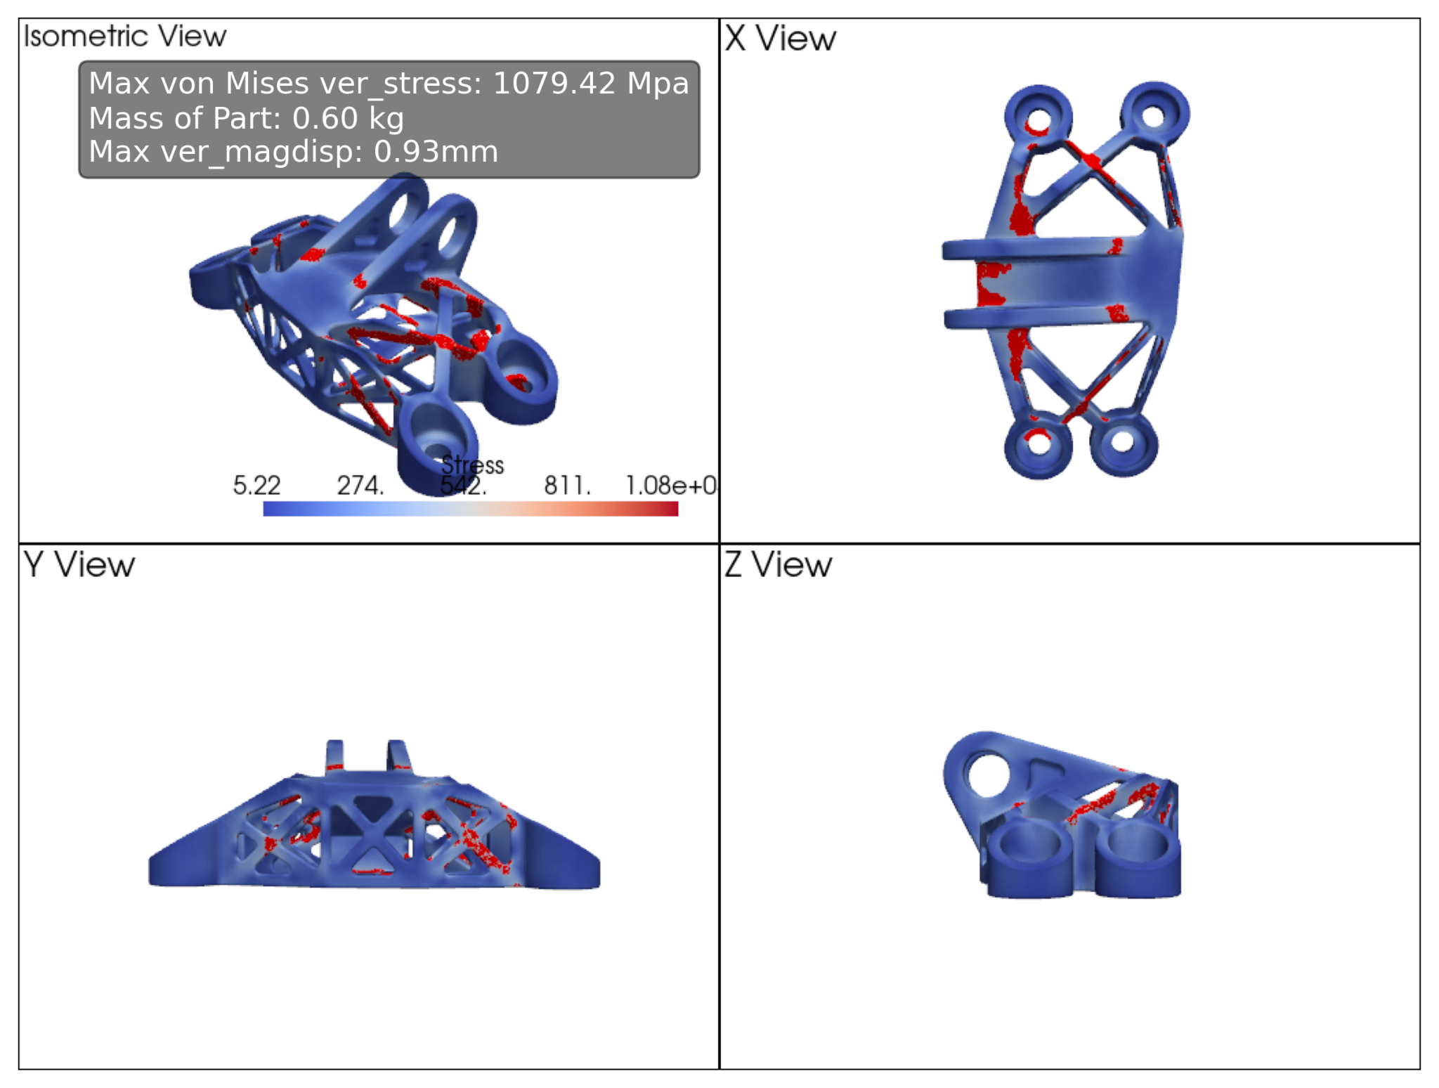
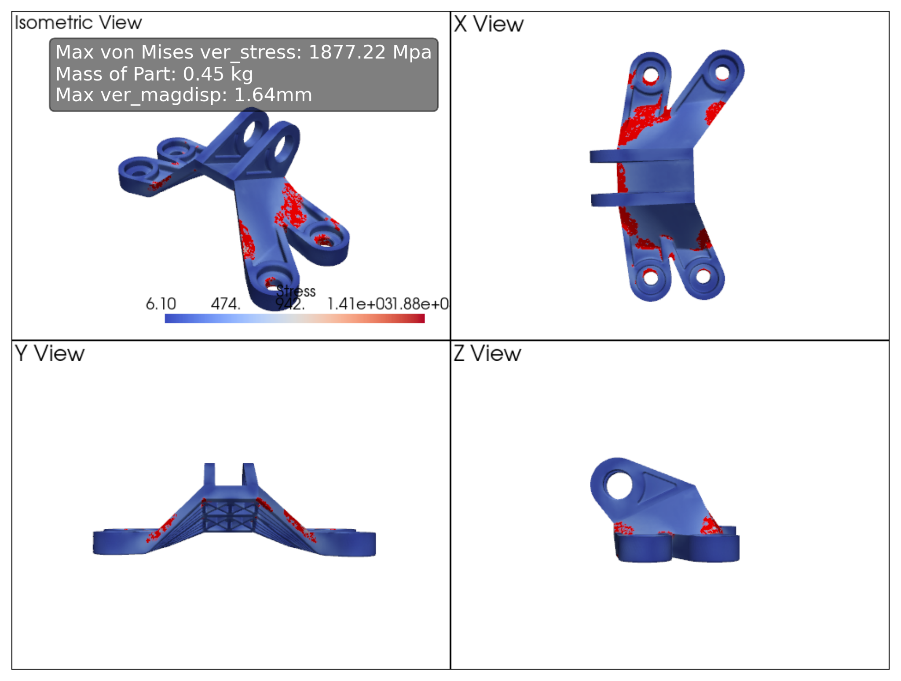
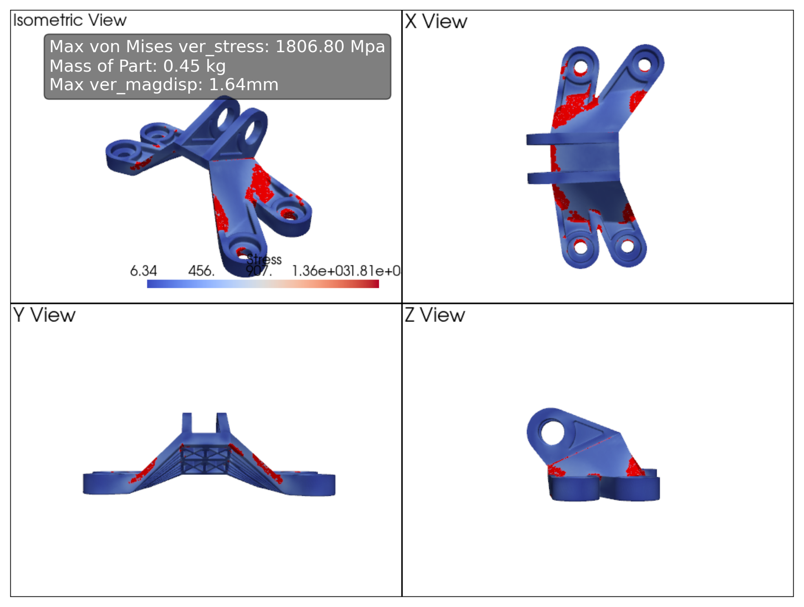
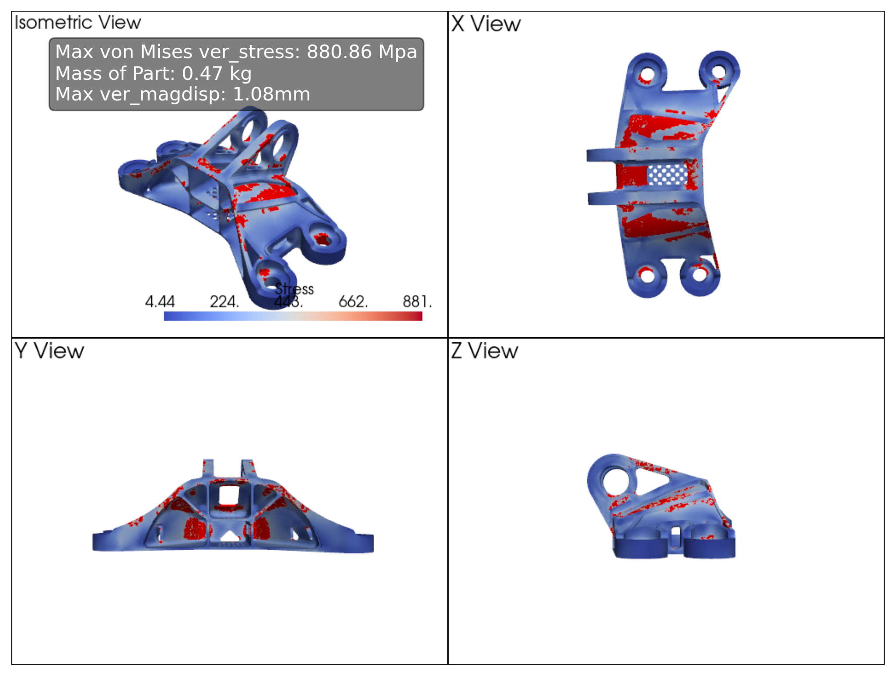

Slide 8
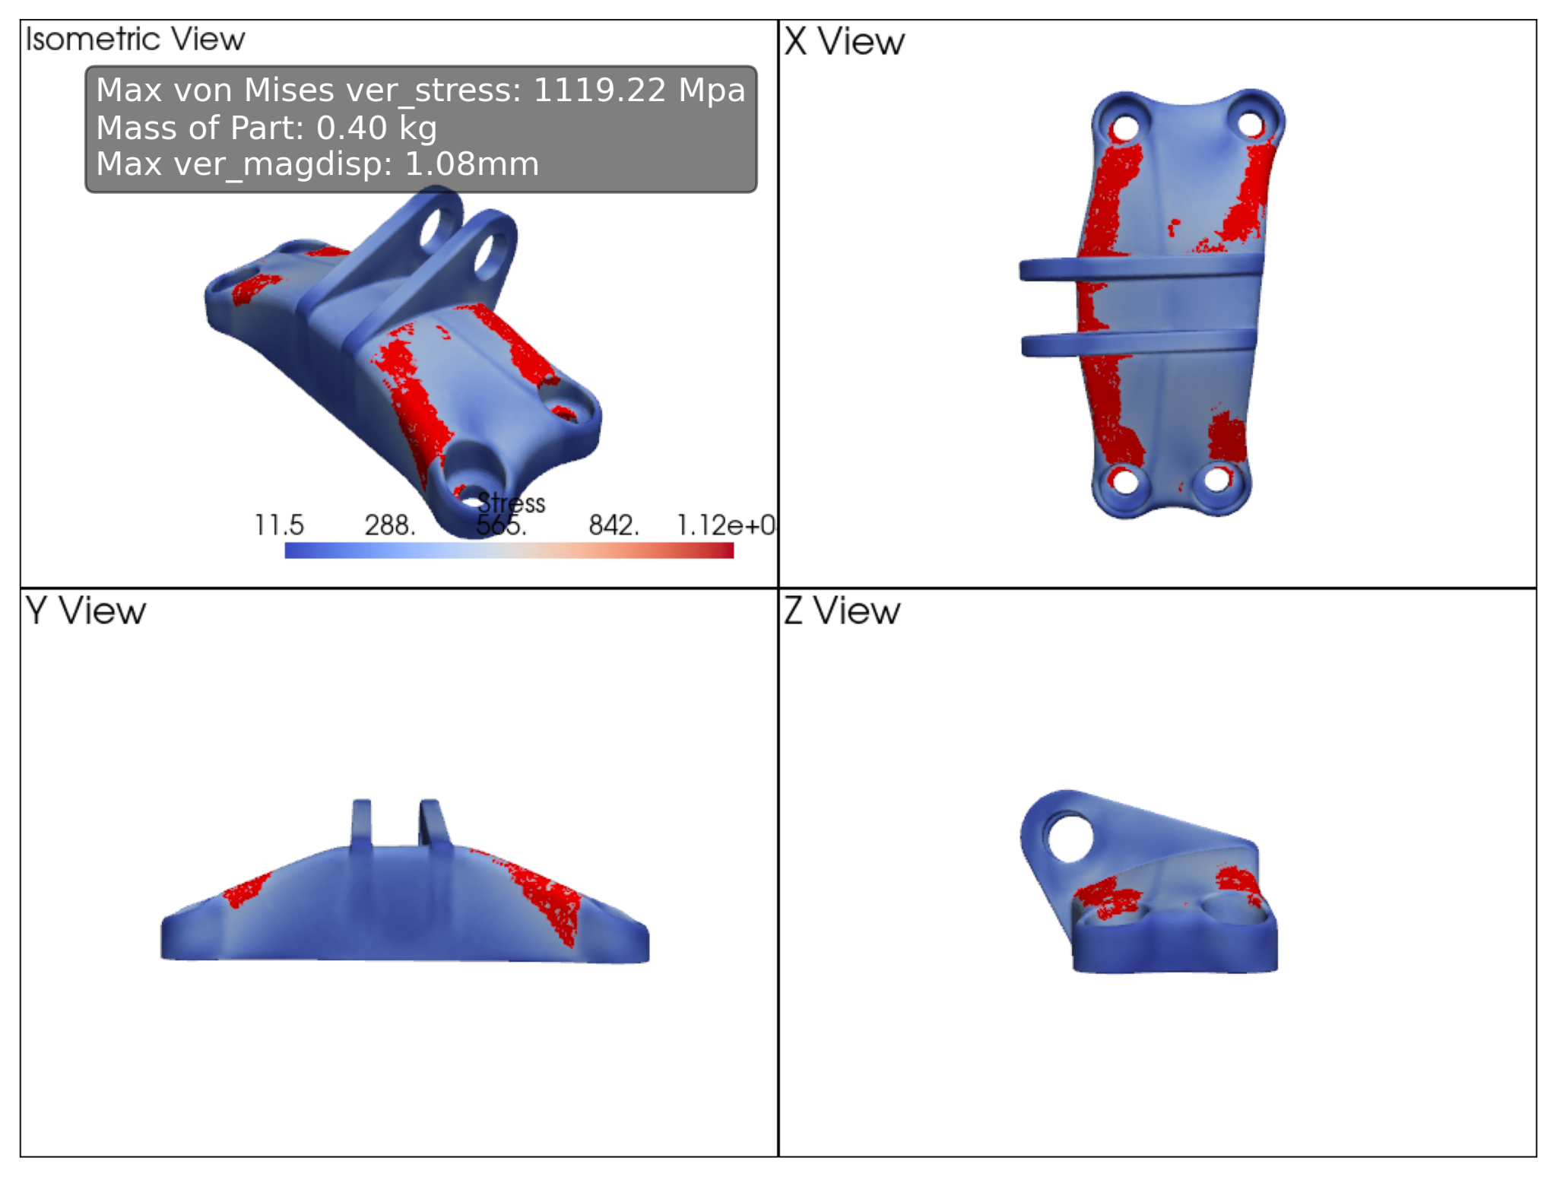
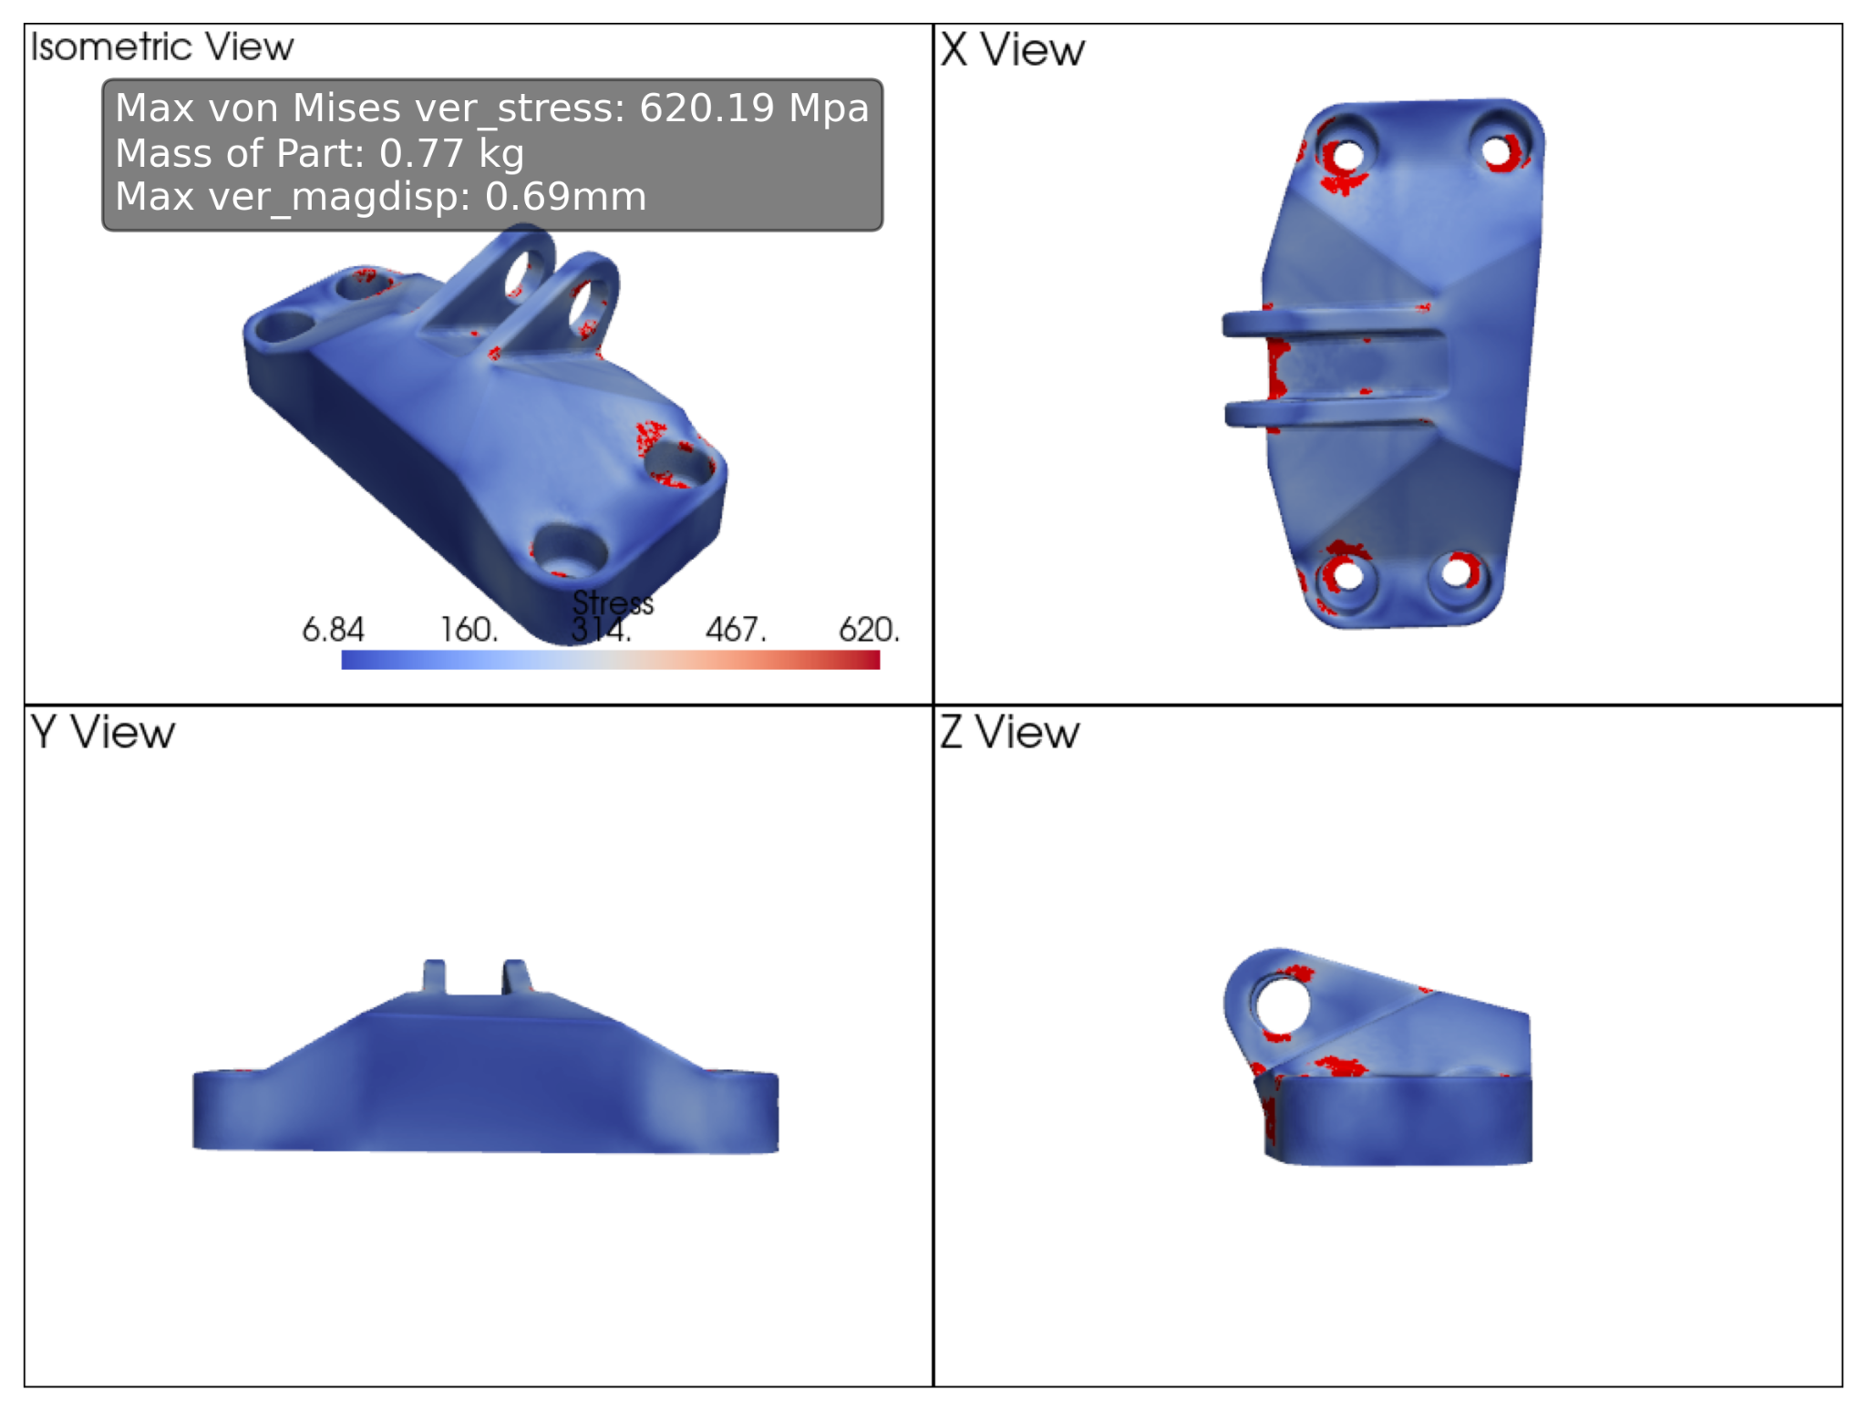
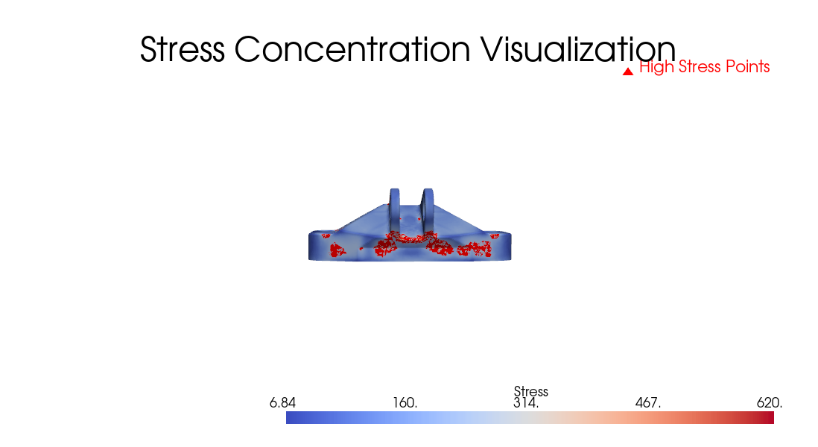
Designs with thin elements
Designs with steep bends
Designs with sudden changes in cross section

Slide 9
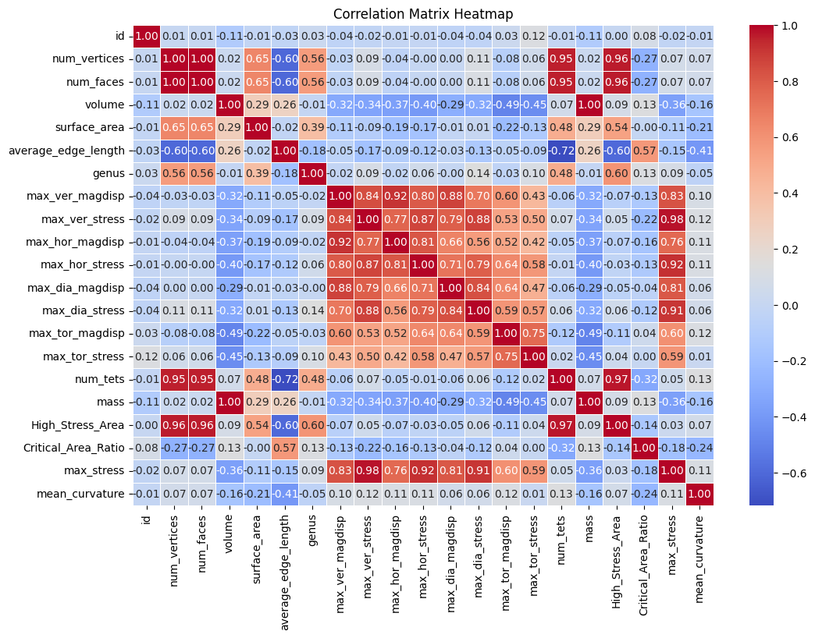
High corr: Stress concentration zones and mesh parameters
Moderate corr: Stress zones and surface area; Critical area ratio and average edge length

Slide 10
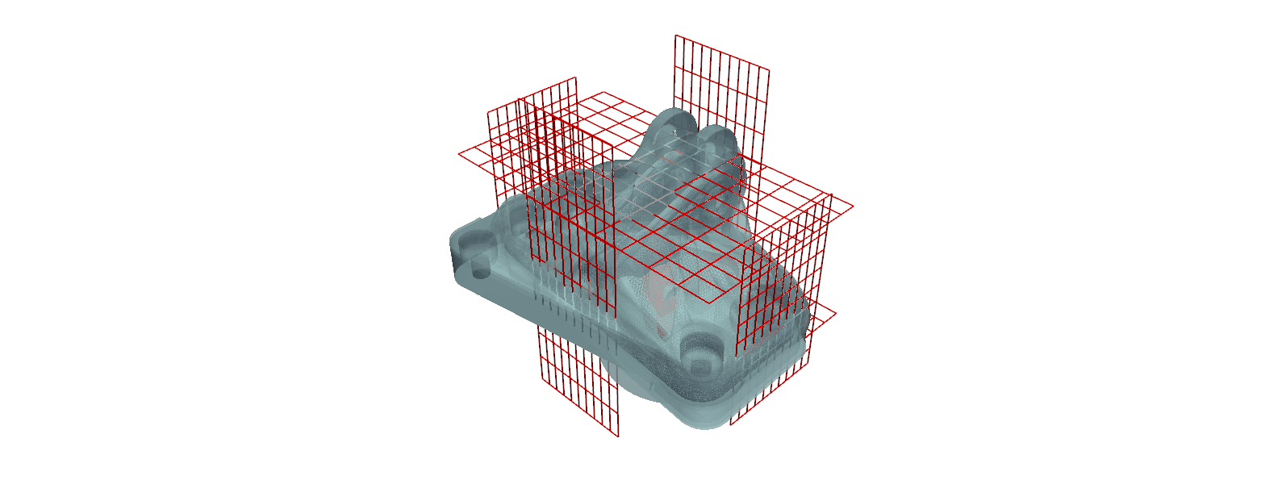
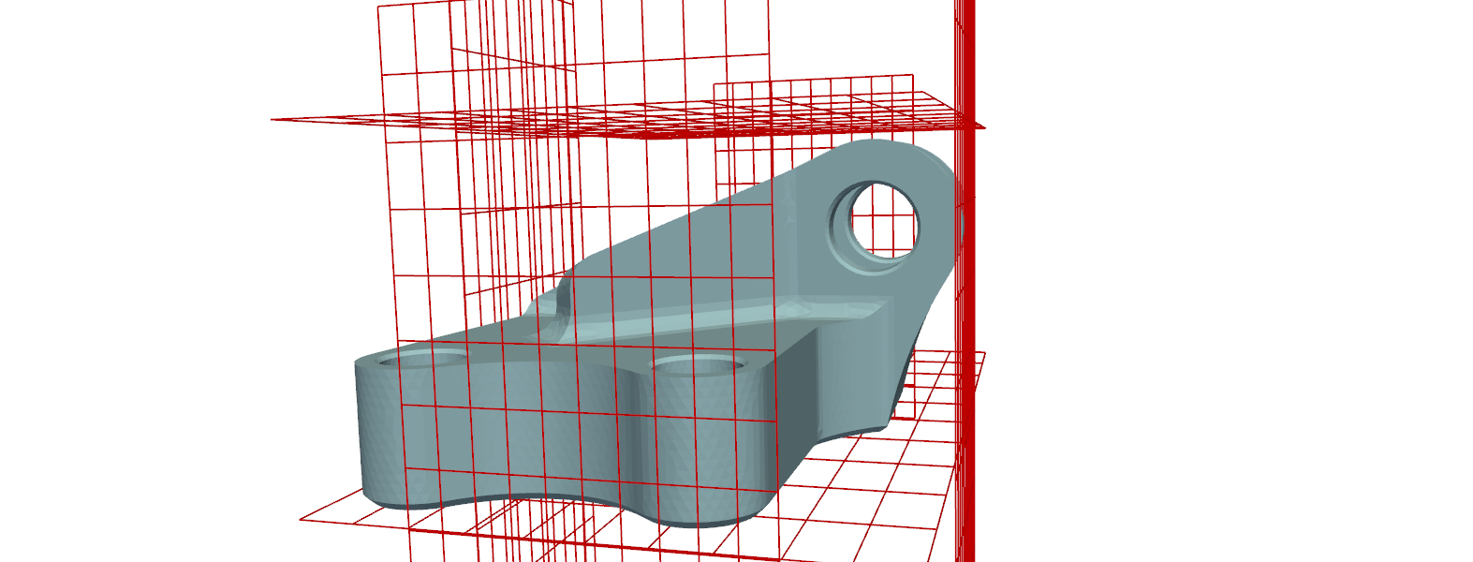
Geometric Outliers
A reference geometry was selected.
Its bounding box was obtained as a reference.
All the other designs were checked; if the design lies beyond the bounds:
Design is an outlier
The image is an example as the correct reference is essential in this case.
Doubt

Slide 11
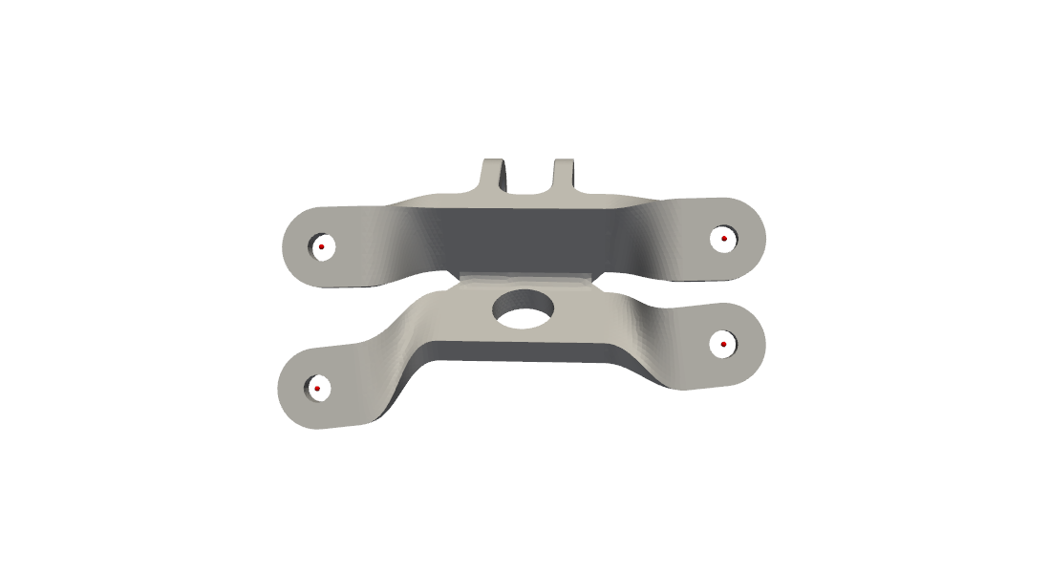
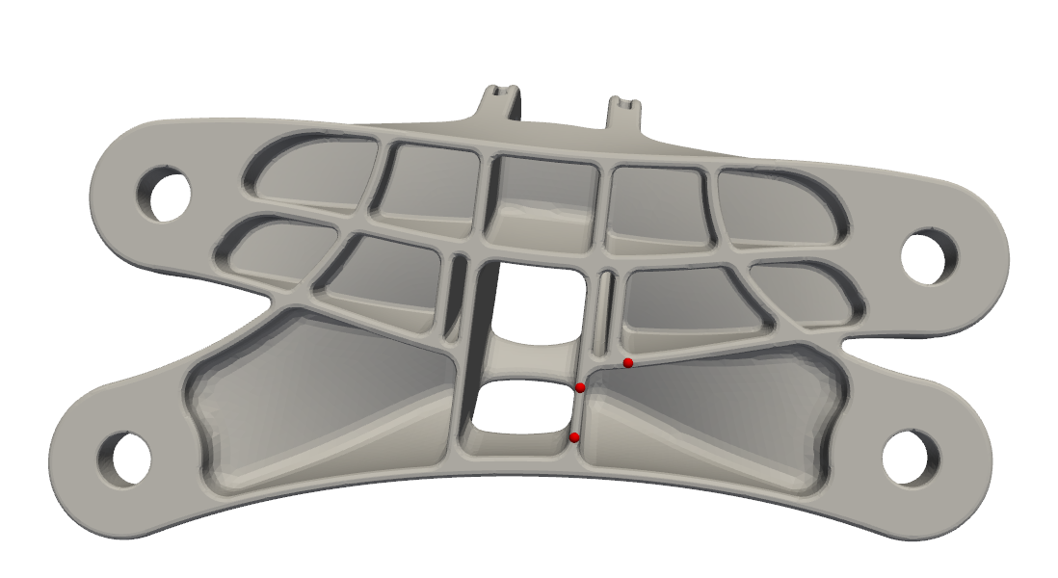
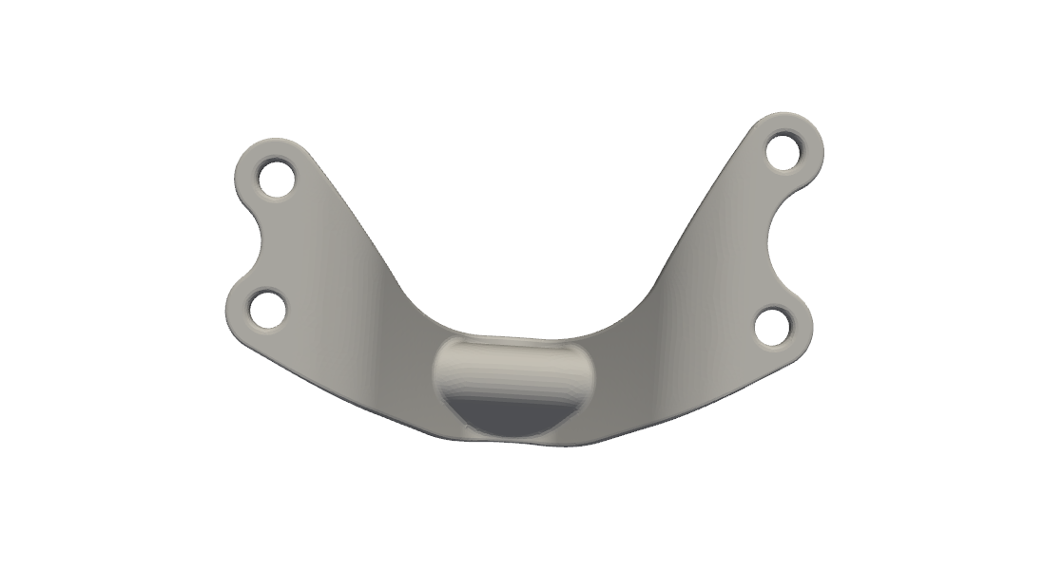
Hunt geometric outliers still on
Latest!
Progress:
The mounting holes are getting located for most.
Some designs with many connectivity issues at the mounting plane, the holes are not getting detected.
Work in progress for a better algorithm
Holes properly detected
Holes wrongly detected
Holes not detected.
Possible reason: mounting plane not planar

Slide 12
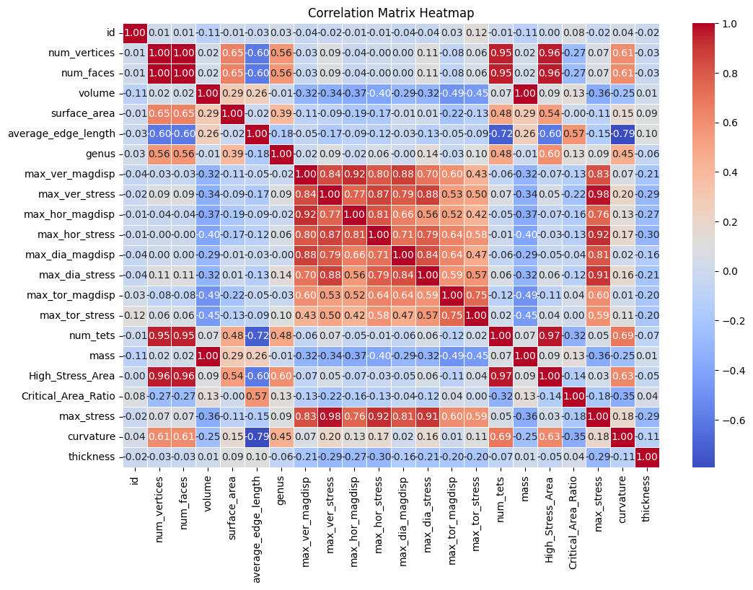
New Correlation Heat Map
Latest!

Slide 13
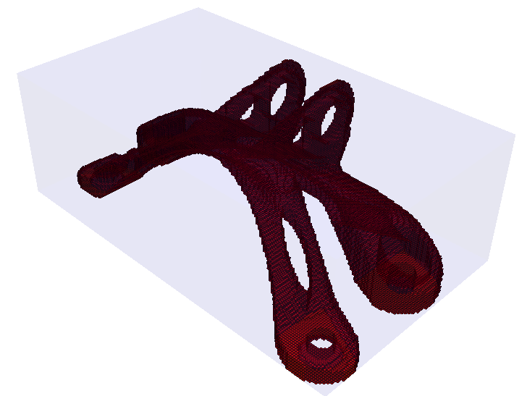
Occupancy Grid

Slide 14
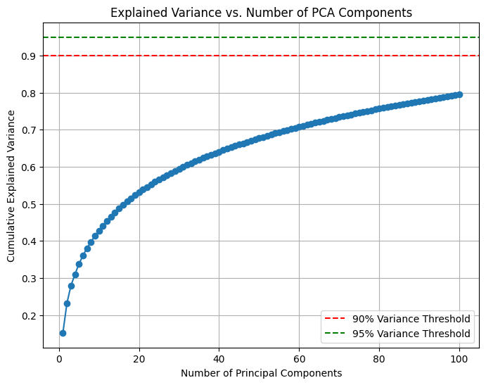
Feature vector analysis
Feature vector was obtained from the occupancy grids
Principal component analysis of Feature Vector.
Outliers were detected by calculating the Z-score.

Slide 15

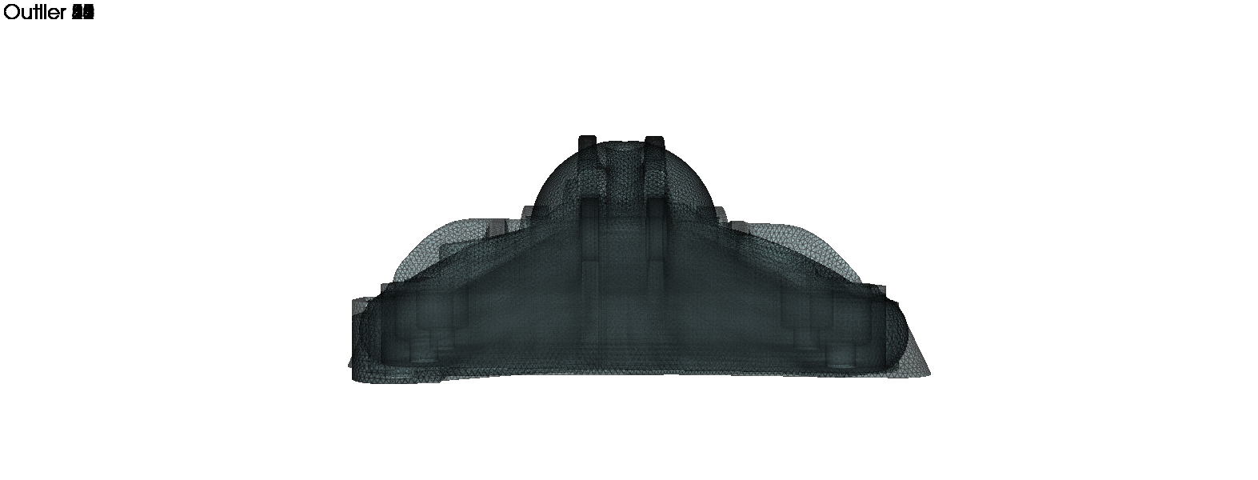
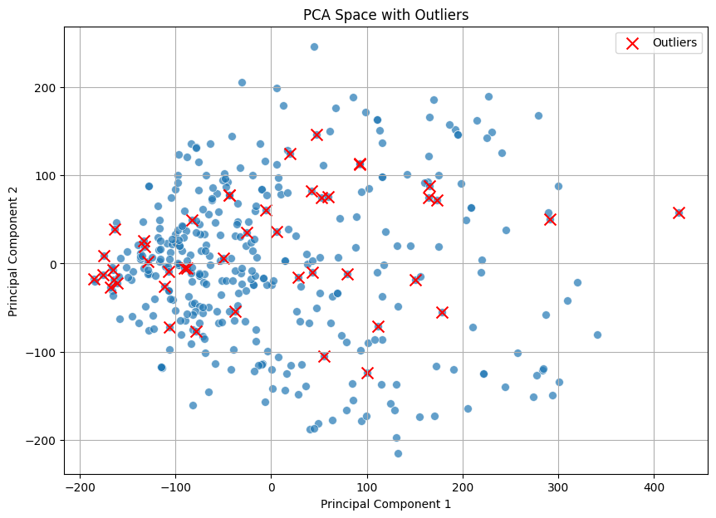

Geometric Outliers

Slide 16
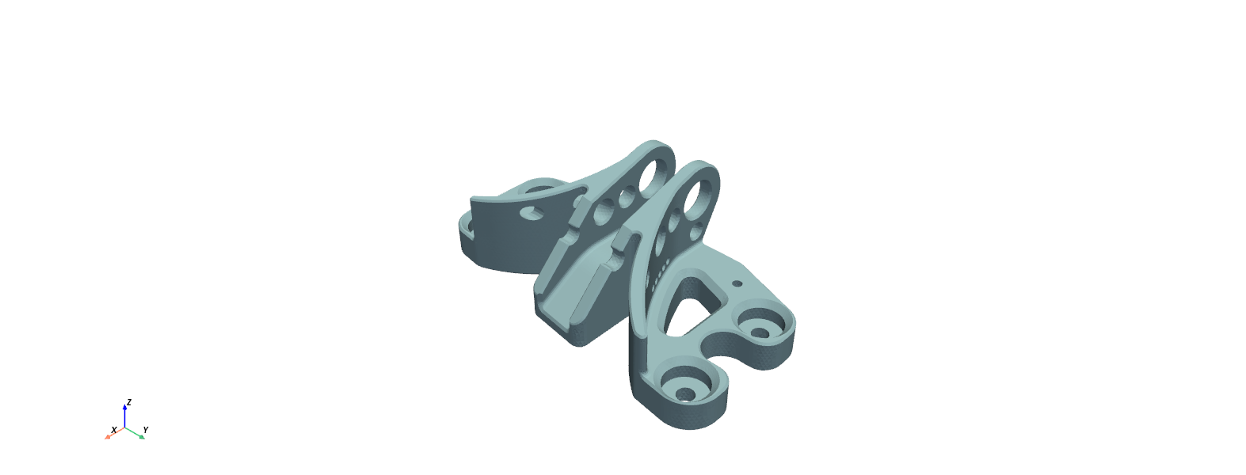
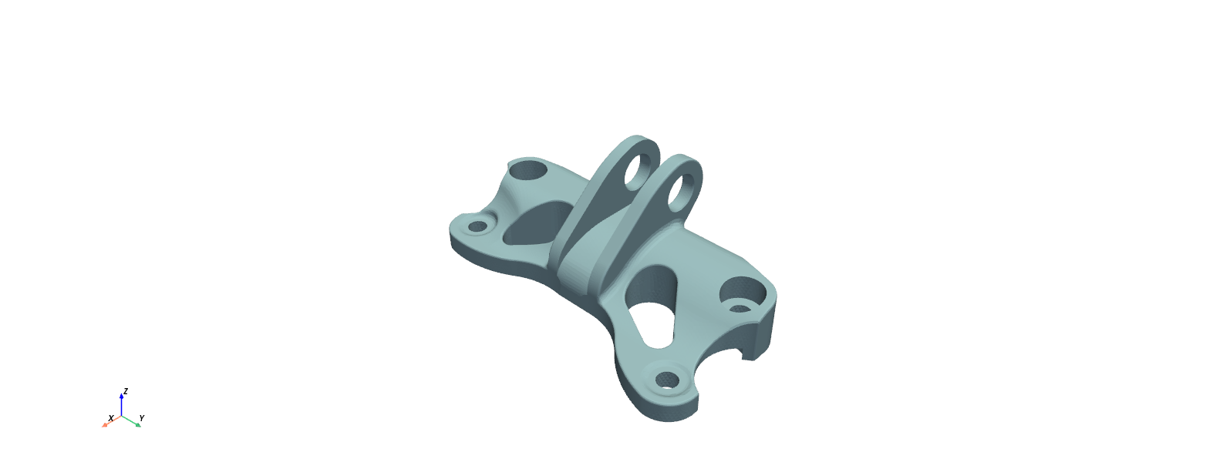
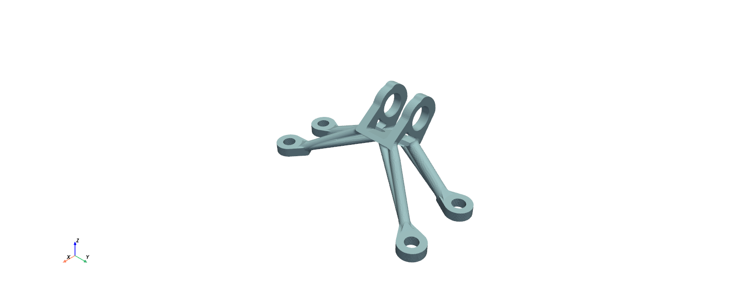
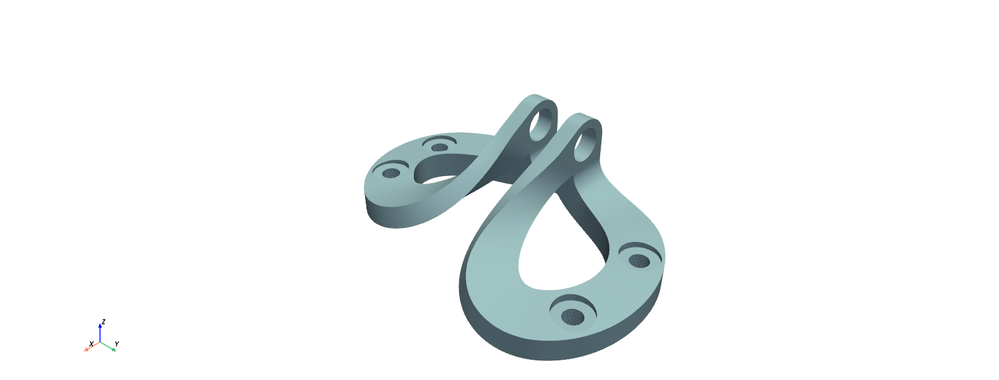
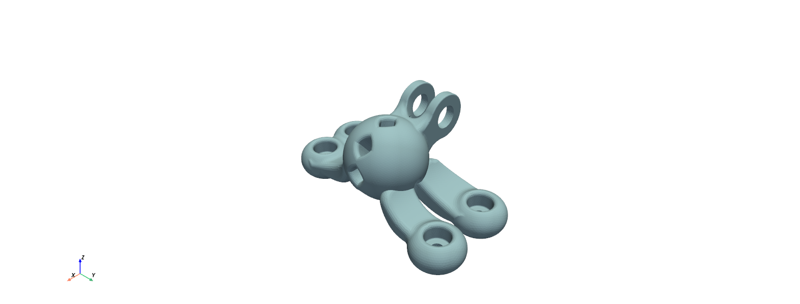
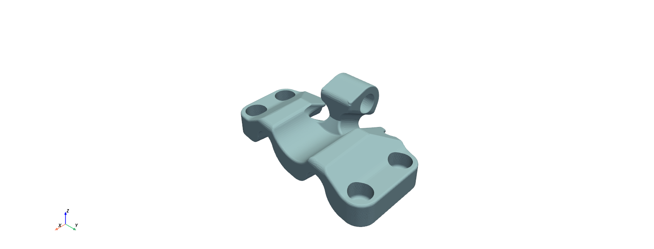
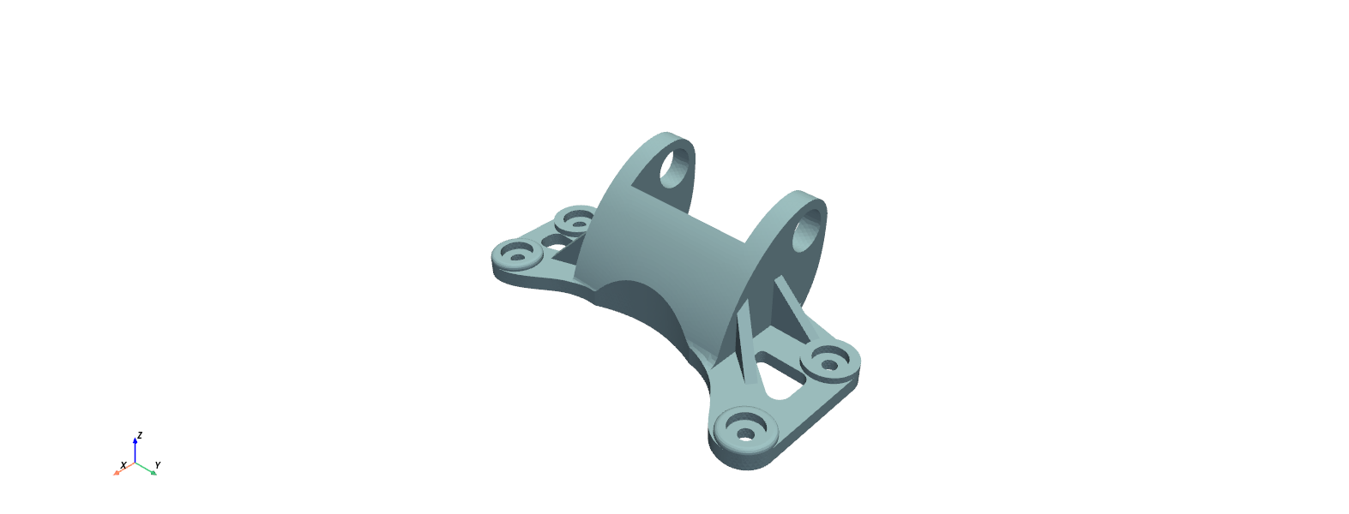
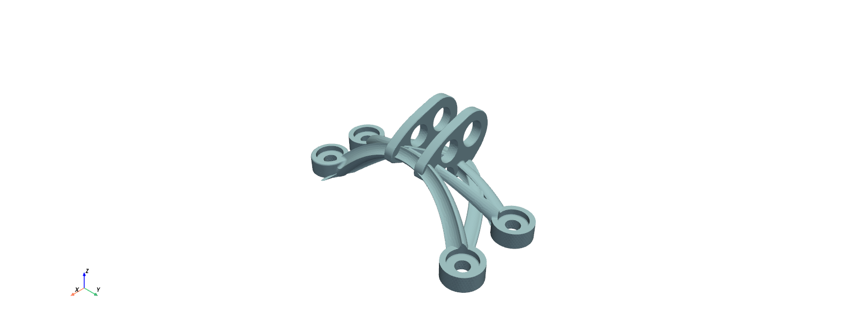
Examples of outliers

Slide 17
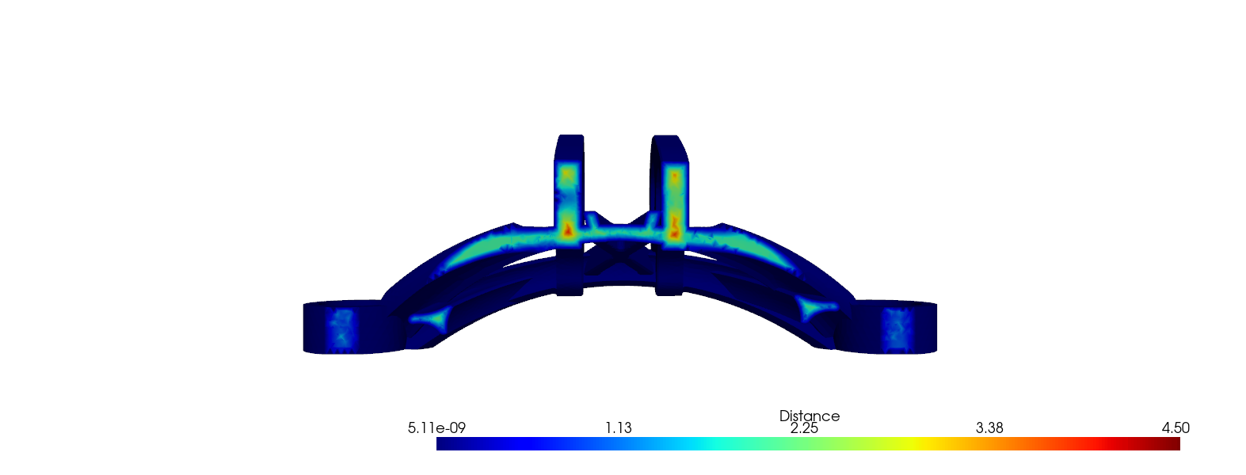
Thickness estimate
The thickness of the design could be estimated by calculating the distance of point clouds along the volumes to the surface.

Slide 18
Work flow
Process occupancy grids to have size 150,150,150. Crop or add padding.
Load data: 256 grids and corresponding max_stress
Split into Train and Test. Train: 204, Test: 94
Train 3D CNN Model. Loss: MSE, LR: 0.000001, Epochs: 70
Conv3DRegression(
(conv1): Conv3d(1, 32, kernel_size=(5, 5, 5), stride=(2, 2, 2), padding=(2, 2, 2))
(conv2): Conv3d(32, 64, kernel_size=(5, 5, 5), stride=(2, 2, 2), padding=(2, 2, 2))
(conv3): Conv3d(64, 128, kernel_size=(3, 3, 3), stride=(2, 2, 2), padding=(1, 1, 1))
(conv4): Conv3d(128, 256, kernel_size=(3, 3, 3), stride=(2, 2, 2), padding=(1, 1, 1))
(conv5): Conv3d(256, 512, kernel_size=(3, 3, 3), stride=(2, 2, 2), padding=(1, 1, 1))
(bn1): BatchNorm3d(32, eps=1e-05, momentum=0.1, affine=True, track_running_stats=True)
(bn2): BatchNorm3d(64, eps=1e-05, momentum=0.1, affine=True, track_running_stats=True)
(bn3): BatchNorm3d(128, eps=1e-05, momentum=0.1, affine=True, track_running_stats=True)
(bn4): BatchNorm3d(256, eps=1e-05, momentum=0.1, affine=True, track_running_stats=True)
(bn5): BatchNorm3d(512, eps=1e-05, momentum=0.1, affine=True, track_running_stats=True)
(fc1): Linear(in_features=64000, out_features=1024, bias=True)
(fc2): Linear(in_features=1024, out_features=256, bias=True)
(fc3): Linear(in_features=256, out_features=1, bias=True)
)

Slide 19
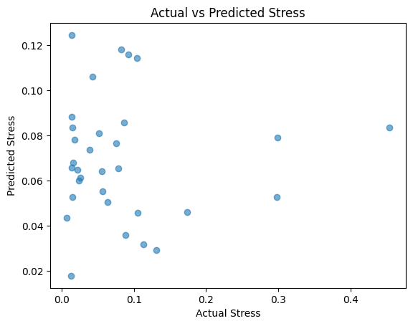
Real vs Prediction

